Slide 1
Chapter 6. Residues and Poles
Weiqi Luo (骆伟祺)
School of Data & Computer Science
Sun Yat-Sen University
Email：luoweiqi@mail.sysu.edu.cn

Slide 2
Chapter 6: Residues and Poles
Isolated Singular Points
Residues
Cauchy’s Residue Theorem
Residue at Infinity
The Three Types of Isolated Singular Points
Residues at Poles; Examples
Zeros of Analytic Functions;
Zeros and Poles
Behavior of Functions Near Isolated singular Points

Slide 3
68. Isolated Singular Points
Singular Point
A point z₀ is called a singular point of a function f if f fails to be analytic at z₀ but is analytic at some point in every neighborhood of z₀.
Isolated Singular Point
A singular point z₀ is said to be isolated if, in addition, there is a deleted neighborhood 0<|z-z₀|<ε of z₀ throughout which f is analytic.

Slide 4
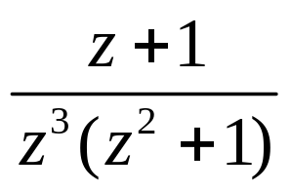
68. Isolated Singular Points
Example 1
The function
has the three isolated singular point z=0 and z=±i.
Example 2
The origin is a singular point of the principal branch
y
y
y
ε
ε
ε
ε
Not Isolated.
x
x
x
x

Slide 5
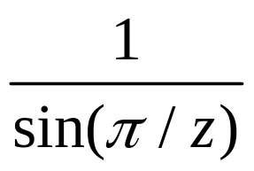
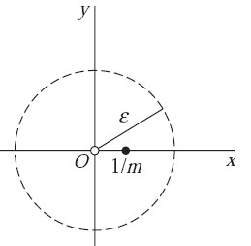
68. Isolated Singular Points
Example 3
The function
has the singular points z=0 and z=1/n (n=±1,±2,…), all lying on the segment of the real axis from z=-1 to z=1.
Each singular point except z=0 is isolated.

Slide 6
68. Isolated Singular Points
If a function is analytic everywhere inside a simple closed contour C except a finite number of singular points : z₁, z₂, …, z_{n}
then those points must all be isolated and the deleted neighborhoods about them can be made small enough to lie entirely inside C.
Isolated Singular Point at ∞
If there is a positive number R₁ such that f is analytic for R₁<|z|<∞, then f is said to have an isolated singular point at z₀=∞.

Slide 7
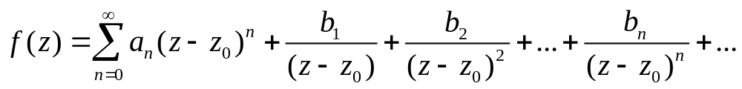
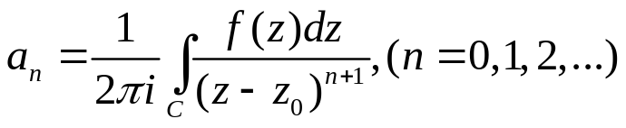
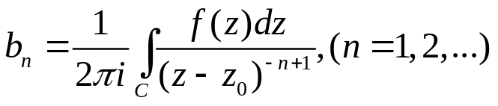
69. Residues
Residues
When z₀ is an isolated singular point of a function f, there is a positive number R₂ such that f is analytic at each point z for which 0<|z-z₀|<R₂. then f(z) has a Laurent series representation
where the coefficients a_{n} and b_{n} have certain integral representations.
where C is any positively oriented simple closed contour around z₀ hat lies in the punctured disk 0<|z-z₀|<R₂.
Refer to pp.198

Slide 8
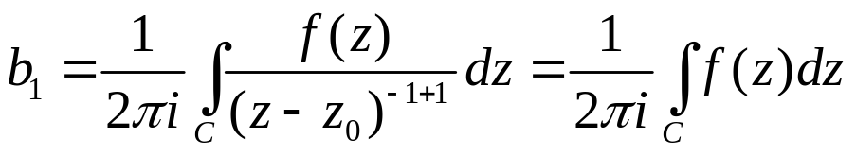
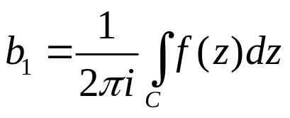
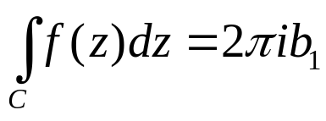
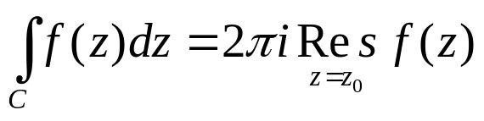
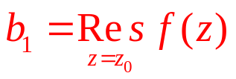
69. Residues
Residues (Cont’)
Then the complex number b₁ is called the residues of f at the isolated singular point z₀, denoted as

Slide 9
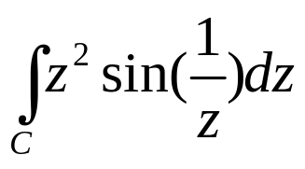
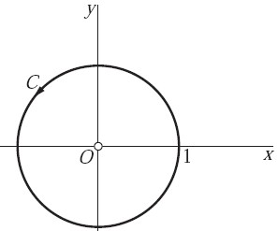
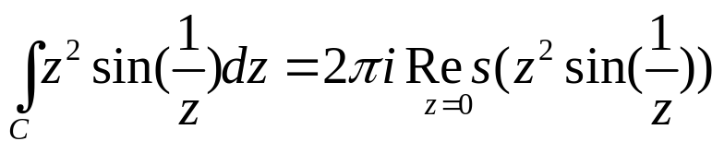
69. Residues
Example 1
Consider the integral
where C is the positively oriented unit circle |z|=1. Since the integrand is analytic everywhere in the finite plane except z=0, it has a Laurent series representation that is valid when 0<|z|<∞.

Slide 10
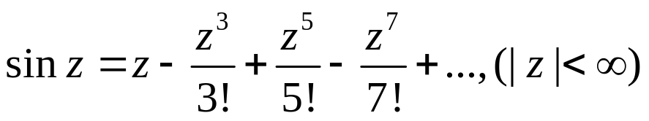
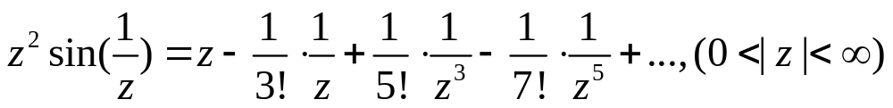
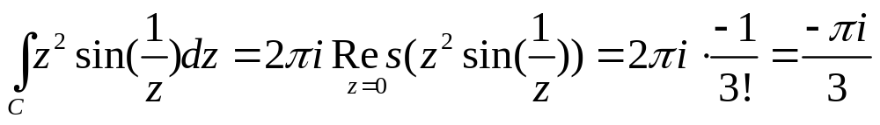
69. Residues
Example 1 (Cont’)

Slide 11
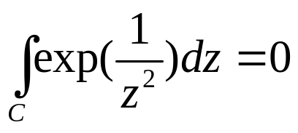
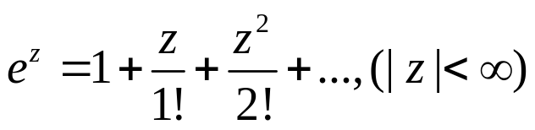
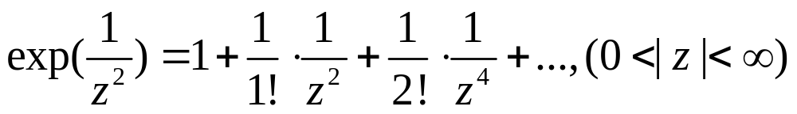
69. Residues
Example 2
Let us show that
when C is the same oriented circle |z|=1. Since the 1/z² is analytic everywhere except at the origin, the same is true of the integrand.
One can write the Laurent series expansion

Slide 12
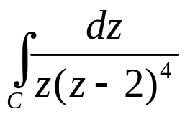
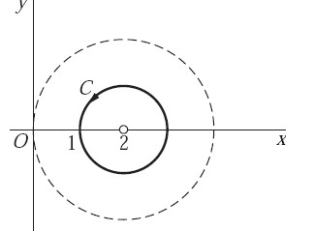
69. Residues
Example 3
A residues can also be used to evaluate the integral
where C is the positively oriented circle |z-2|=1.
Since the integrand is analytic everywhere in the finite plane except at the point z=0 and z=2. It has a Laurent series representation that is valid in the punctured disk

Slide 13
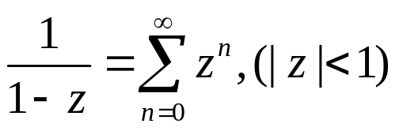
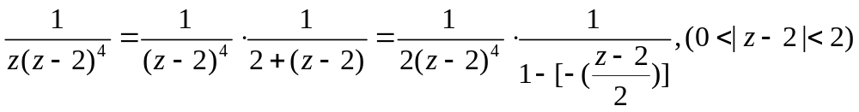
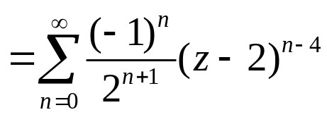
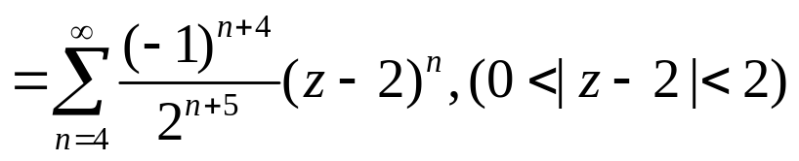
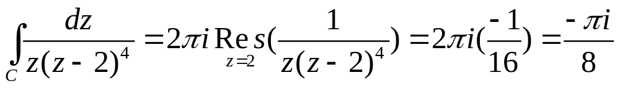
69. Residues
Example 3 (Cont’)

Slide 14
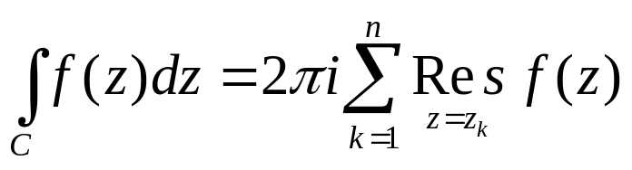
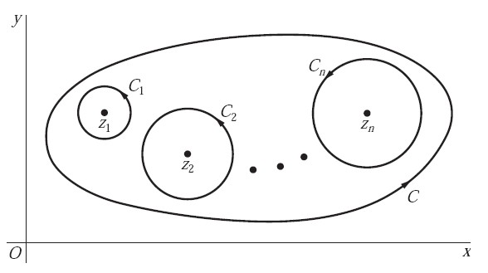
70. Cauchy’s Residue Theorem
Theorem
Let C be a simple closed contour, described in the positive sense. If a function f is analytic inside and on C except for a finite number of singular points z_{k} (k = 1, 2, . . . , n) inside C, then

Slide 15
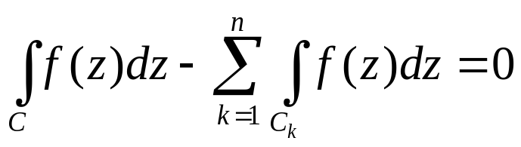
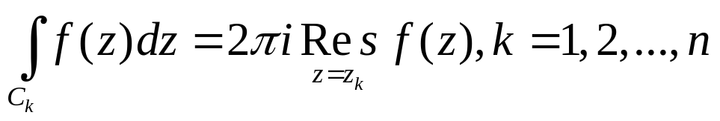
70. Cauchy’s Residue Theorem
Theorem (Cont’)
Proof: Let the points z_{k} (k=1,2,…n) be centers of positively oriented circles C_{k} which are interior to C and are so small that no two of them have points in common (possible?).
Then f is analytic on all of these contours and throughout the multiply connected domain consisting of the points inside C and exterior to each C_{k}, then

Slide 16
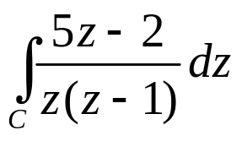
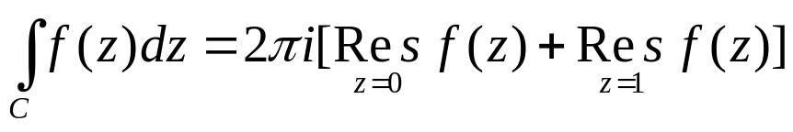

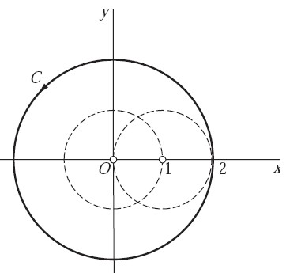
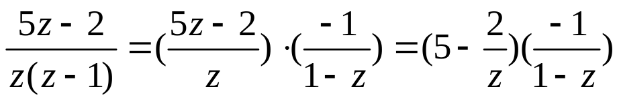
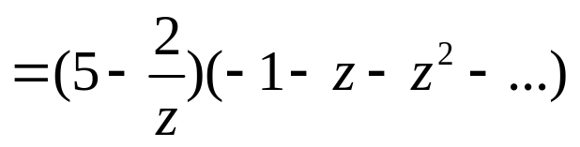
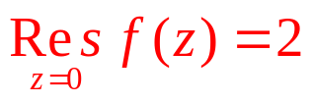
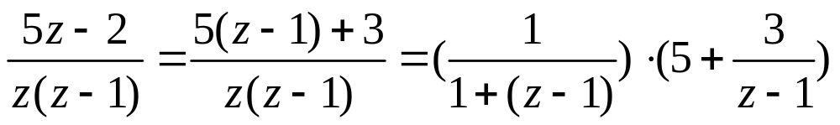
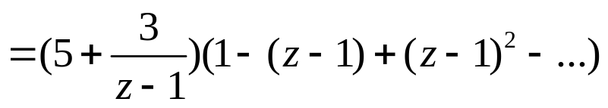
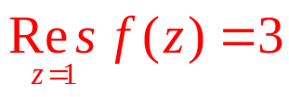
70. Cauchy’s Residue Theorem
Example
Let us use the theorem to evaluate the integral

Slide 17
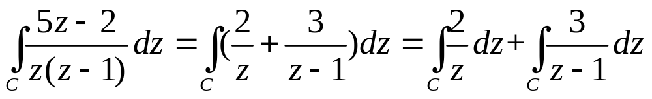
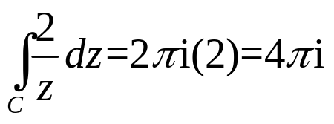
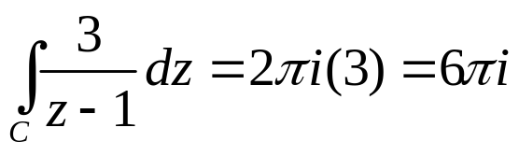
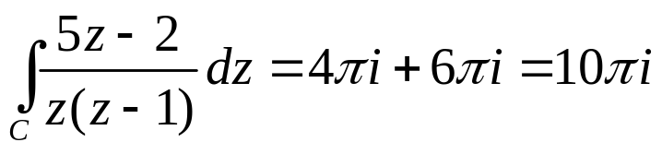
70. Cauchy’s Residue Theorem
Example (Cont’)
In this example, we can write

Slide 18
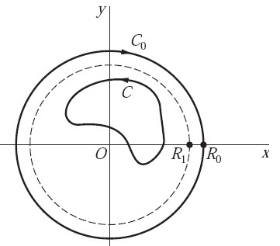
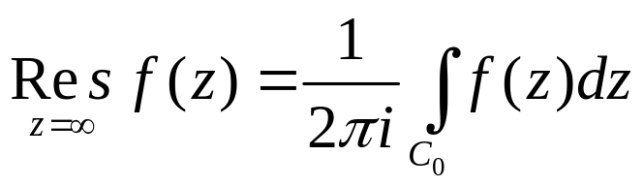
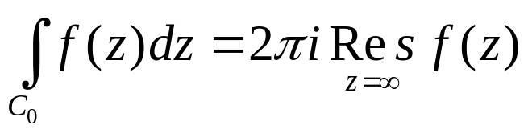
71. Residue at Infinity
Definition
Suppose a function f is analytic throughout the finite plane except for a finite number of singular points interior to a positively oriented simple close contour C. Let R₁ is a positive number which is large enough that C lies inside the circle |z|=R₁
The function f is evidently analytic throughout the domain R₁<|z|<∞. Let C₀ denote a circle |z|=R₀, oriented in the clockwise direction, where R₀>R₁. The residue of f at infinity is defined by means of the equation

Slide 19
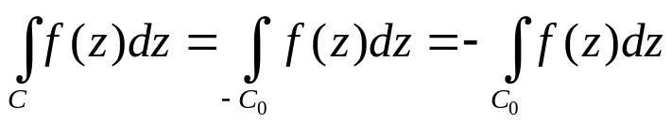
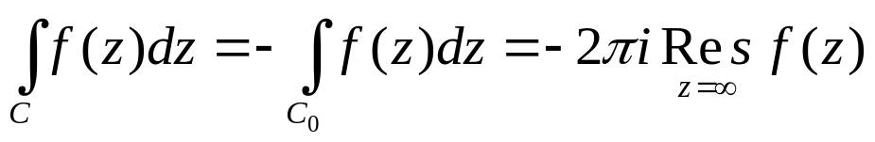
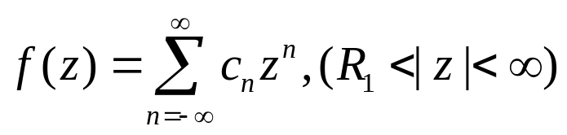






71. Residue at Infinity
Refer to the Corollary in pp.159
Based on the definition of the residue of f at infinity

Slide 20

71. Residue at Infinity
Theorem
If a function f is analytic everywhere in the finite plane except for a finite number of singular points interior to a positively oriented simple closed contour C, then

Slide 21



71. Residue at Infinity
Example
In the example in Sec. 70, we evaluated the integral of
around the circle |z|=2, described counterclockwise, by finding the residues of f(z) at z=0 and z=1, since

Slide 22
71. Homework
pp. 239-240
Ex. 2, Ex. 3, Ex. 5, Ex. 6

Slide 23

72. The Three Types of Isolated Singular Points
Laurent Series
If f has an isolated singular point z₀, then it has a Laurent series representation
In a punctured disk 0<|z-z₀|<R₂.
is called the principal part of f at z₀
In the following, we use the principal part to identify the isolated singular point z₀ as one of three special types.

Slide 24



72. The Three Types of Isolated Singular Points
Type #1:
If the principal part of f at z₀ at least one nonzero term but the number of such terms is only finite, the there exists a positive integer m (m≥1) such that
and
Where b_{m} ≠ 0, In this case, the isolated singular point z₀ is called a pole of order
m. A pole of order m=1 is usually referred to as a simple pole.

Slide 25
72. The Three Types of Isolated Singular Points
Example 1
Observe that the function
has a simple pole (m=1) at z₀=2. It residue b1 there is 3.

Slide 26



72. The Three Types of Isolated Singular Points
Example 2
From the representation
One can see that f has a pole of order m=2 at the origin and that

Slide 27
72. The Three Types of Isolated Singular Points
Type #2
If the principal part of f at z₀ has no nonzero term
z₀ is known as a removable singular point, and the residues at a removable singular point is always zero.
Note: f is analytic at z₀ when it is assigned the value a₀ there. The singularity z₀ is, therefore, removed.

Slide 28


72. The Three Types of Isolated Singular Points
Example 4
The point z₀=0 is a removable singular point of the function
Since
when the value f(0)=1/2 is assigned, f becomes entire.

Slide 29

72. The Three Types of Isolated Singular Points
Type #3
If the principal part of f at z₀ has infinite number of nonzero terms, and z₀ is said to be an essential singular point of f.
Example 3
Consider the function
has an essential singular point at z₀=0. where the residue b₁ is 1.

Slide 30
72. Homework
pp. 243
Ex. 1, Ex. 2, Ex. 3

Slide 31


73. Residues at Poles
Theorem
An isolated singular point z₀ of a function f is a pole of order m if and only if f (z) can be written in the form
where φ(z) is analytic and nonzero at z₀ . Moreover,

Slide 32
73. Residues at Poles
Proof the Theorem
Assume f(z) has the following form
where φ(z) is analytic and nonzero at z₀, then it has Taylor series representation
b₁
a pole of order m, φ(z₀)≠0

Slide 33

73. Residues at Poles
On the other hand, suppose that
The function φ(z) defined by means of the equations
Evidently has the power series representation
Throughout the entire disk |z-z₀|<R₂. Consequently, φ(z) is analytic in that disk, and, in particular, at z₀. Here φ(z₀) = b_{m}≠0.

Slide 34



74. Examples
Example 1
The function
has an isolated singular point at z=3i and can be written
Since φ(z) is analytic at z=3i and φ(3i)≠0, that point is a simple pole of the function f, and the residue there is
The point z=-3i is also a simple pole of f, with residue B₂= 3+i/6

Slide 35



74. Examples
Example 2
If
then
The function φ(z) is entire, and φ(i)=i ≠0. Hence f has a pole of order 3 at z=i, with residue

Slide 36


74. Examples
Example 3
Suppose that
where the branch
find the residue of f at the singularity z=i.
The function φ(z) is analytic at z=i, and φ(i)≠0, thus f has a simple pole there, the residue is B= φ(i)=-π³/16.

Slide 37




74. Examples
Example 5
Since z(e^{z}-1) is entire and its zeros are
z=2nπi, (n=0, ±1, ±2,… )
the point z=0 is clearly an isolated singular point of the function
From the Maclaurin series
We see that
Thus

Slide 38

74. Examples
Example 5 (Cont’)
since φ(z) is analytic at z=0 and φ(0) =1≠0, the point z=0 is a pole of the second order. Thus, the residue is B= φ’(0)
Then B=-1/2.

Slide 39
74. Examples
pp. 248
Ex. 1, Ex. 3, Ex. 6

Slide 40



75. Zeros of Analytic Functions
Definition
Suppose that a function f is analytic at a point z₀. We known that all of the derivatives f^{(n)}(z₀) (n=1,2,…) exist at z₀. If f(z₀)=0 and if there is a positive integer m such that f^{(m)}(z₀)≠0 and each derivative of lower order vanishes at z₀, then f is said to have a zero of order m at z₀.

Slide 41


75. Zeros of Analytic Functions
Theorem 1
Let a function f be analytic at a point z₀. It has a zero of order m at z₀ if and only if there is a function g, which is analytic and nonzero at z₀ , such that
Proof:
Assume that f(z)=(z-z₀)^{m}g(z) holds,
Note that g(z) is analytics at z₀, it has a Taylor series representation

Slide 42



75. Zeros of Analytic Functions
Thus f is analytic at z₀, and
Hence z₀ is zero of order m of f.
2) Conversely, if we assume that f has a zero of order m at z₀, then
g(z)

Slide 43

75. Zeros of Analytic Functions
The convergence of this series when |z-z₀|<ε ensures that g is analytic
in that neighborhood and, in particular, at z₀, Moreover,
This completes the proof of the theorem.

Slide 44



75. Zeros of Analytic Functions
Example 1
The polynomial
has a zero of order m=1 at z₀=2 since
where
and because f and g are entire and g(2)=12≠0. Note how the fact that z₀=2 is a zero of order m=1 of f also follows from the observations that f is entire and that f(2)=0 and f’(2)=12≠0.

Slide 45





75. Zeros of Analytic Functions
Example 2
The entire function
has a zero of order m=2 at the point z₀=0 since
In this case,

Slide 46
75. Zeros of Analytic Functions
Theorem 2
Given a function f and a point z₀, suppose that
f is analytic at z₀ ;
f (z₀) = 0 but f (z) is not identically equal to zero in any neighborhood of z₀.
Then f (z) ≠ 0 throughout some deleted neighborhood 0 < |z − z₀| < ε of z₀.

Slide 47

75. Zeros of Analytic Functions
Proof:
Since (a) f is analytic at z_{0,} (b) f (z₀) = 0 but f (z) is not identically equal
to zero in any neighborhood of z_{0 ,} f must have a zero of some finite order
m at z₀ (why?). According to Theorem 1, then
where g(z) is analytic and nonzero at z₀.
Since g(z₀)≠0 and g is continuous at z₀, there is some neighborhood
|z-z₀|<ε, g(z) ≠0.
Consequently, f(z) ≠0 in the deleted neighborhood 0<|z-z₀|<ε (why?)

Slide 48


75. Zeros of Analytic Functions
Theorem 3
Given a function f and a point z₀, suppose that
f is analytic throughout a neighborhood N₀ of z₀
f (z) = 0 at each point z of a domain D or line segment L containing z_{0.}
Then in N0
That is, f(z) is identically equal to zero throughout N0

Slide 49

75. Zeros of Analytic Functions
Proof:
We begin the proof with the observation that under the stated conditions,
f (z) ≡ 0 in some neighborhood N of z₀.
For, otherwise, there would be a deleted neighborhood of z₀ throughout
which f(z)≠0, according to Theorem 2; and that would be inconsistent
with the condition that f(z)=0 everywhere in a domain D or on a line
segment L containing z₀.
Since f (z) ≡ 0 in the neighborhood N, then, it follows that all of
the coefficients in the Taylor series for f (z) about z₀ must be zero.

Slide 50

75. Zeros of Analytic Functions
Lemma (pp.83)
Suppose that
a function f is analytic throughout a domain D;
f (z) = 0 at each point z of a domain or line segment contained in D.
Then f (z) ≡ 0 in D; that is, f (z) is identically equal to zero throughout D.

Slide 51


76. Zeros and Poles
Theorem 1
Suppose that
two functions p and q are analytic at a point z₀;
p(z₀)≠0 and q has a zero of order m at z₀.
Then the quotient p(z)/q(z) has a pole of order m at z₀.
Proof:
Since q has a zero of order m at z₀
where g is analytic at z₀ and g(z₀) ≠0
where φ(z)=p/g is analytic and φ(z₀)≠0 Why?
Therefore, p(z)/q(z) has a pole of order m at z₀

Slide 52


76. Zeros and Poles
Example 1
Two functions
are entire, and we know that q has a zero of order m=2 at the point z₀=0.
Hence it follows from Theorem 1 that the quotient
Has a pole of order 2 at that point.

Slide 53







76. Zeros and Poles
Theorem 2
Let two functions p and q be analytic at a point z₀ . If
then z₀ is a simple pole of the quotient p(z)/q(z) and
a zero of order m=1 at the point z₀
pp. 252
Theorem 1
pp. 244
Theorem (m=1)

Slide 54

76. Zeros and Poles
Example 2
Consider the function
which is a quotient of the entire functions p(z) = cos z and q(z) = sin z. Its singularities occur at the zeros of q, or at the points z=nπ (n=0, ±1,±2,…)
Since p(nπ) =(-1)^{n} ≠ 0, q(nπ)=0, and q’(nπ)=(-1)n ≠ 0,
Each singular point z=nπ of f is a simple pole, with residue B_{n}= p(nπ)/ q’(nπ)= (-1)^{n}/(-1)^{n}=1

Slide 55


76. Zeros and Poles
Example 4
Since the point
is a zero of polynomial z⁴+4. it is also an isolated singularity of the function
writing p(z)=z and q(z)=z⁴+4, we find that
p(z₀)=z₀ ≠ 0, q(z₀)=0, and q’(z₀)=4z₀³ ≠ 0
And hence that z₀ is a simple pole of f, and the residue is
B₀=p(z₀)/ q’(z₀)= -i/8

Slide 56
76. Homework
pp. 255-257
Ex. 6, Ex. 7, Ex. 8

